Slide 1

Real Time Rendering CS7GV3-Assignment 5
Perspective Shadow Mapping

Slide 2
Index
● Resource Referenced
● Shadow Mapping – Creating Map
● Shadow Mapping – Using Map
● Shadow Mapping – Shadow Acne
● Shadow Mapping – Oversampling
● Shadow Mapping – PCF
● Implementation
● Evaluation

Slide 3
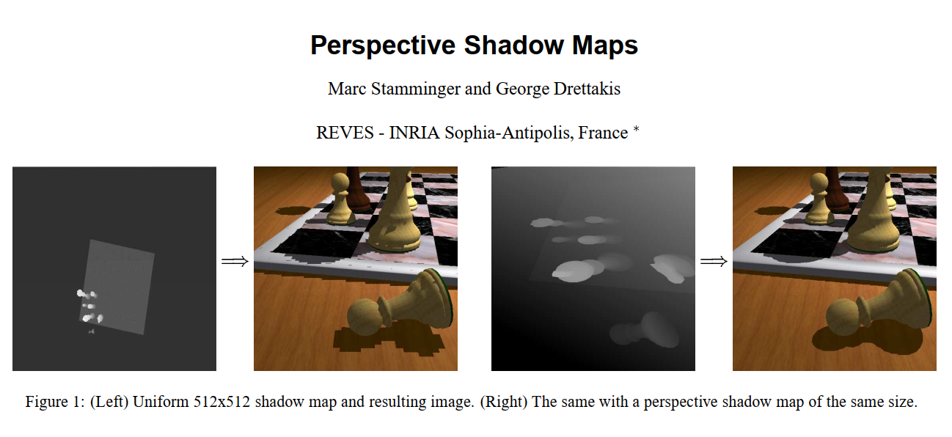
Resources Referenced
● M. Stamminger and G. Drettakis Perspective Shadow Maps ACM Transactions on Graphics 2002

Slide 4
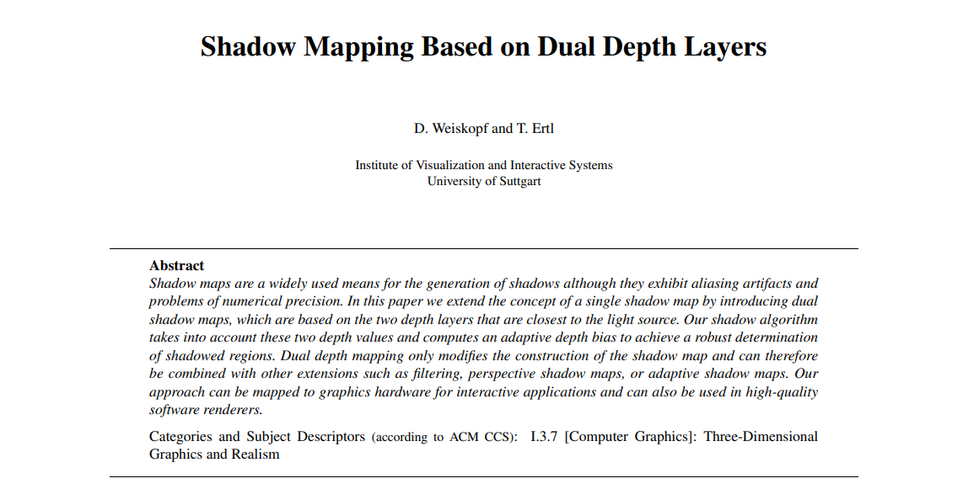
Resources Referenced
● D. Weiskopf and T. Ertl, Shadow Mapping Based on Dual Depth Layers, University of Stuttgart 2003
● Computer Graphics with Modern OpenGL and C++ Udemy tutorial 2017

Slide 5
● Literally create a “map” of the shadows made by a light.
● Use this map to determine where not to apply light.
● The map is held as a 2D texture (sampler2D in shader).
● Map is created using a “Framebuffer”.
● Framebuffer then writes to texture.
● Therefore, at least two rendering passes needed!
● One for creating shadow map, second for drawing scene.
Resource Referenced

Slide 6
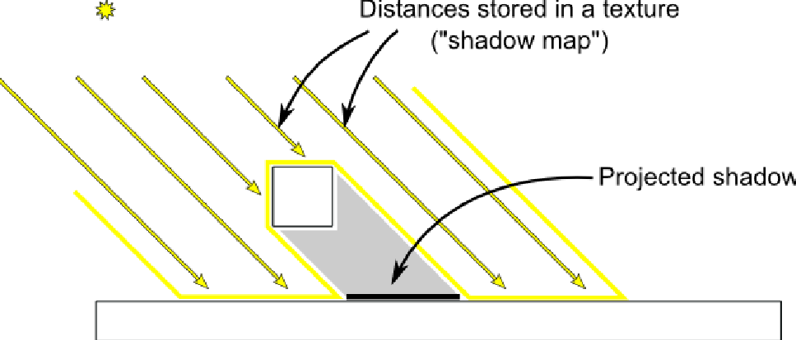
Shadow Mapping – Creating Map
For first pass: Render the scene from perspective of a light source.

Slide 7
Creating Map
● Shaders don’t just create color output!
● Recall from Rendering Pipeline: Per-Sample Operations.
● Depth Tests using Depth Buffer values.
● Depth Buffer is another buffer along with Color Buffer that holds a value between 0 and 1 that determines how deep in to frustum a fragment is.
● 0 is on the Near Plane (close to the camera).
● 1 is on the Far Plane (far from the camera).

Slide 8
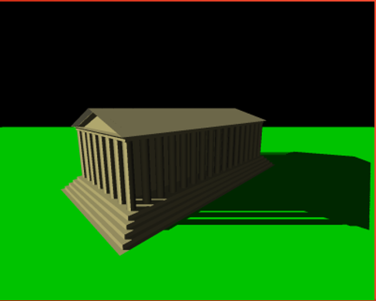
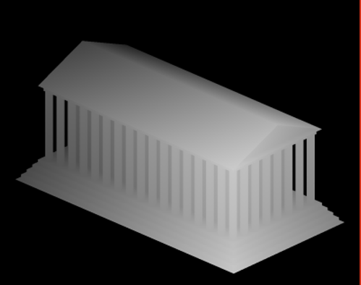
Creating Map

Slide 9
Creating Map
● Shader itself is simple:
● 1. Apply Projection and View matrices as if light source is the camera.
● 2. Apply model matrix of each object.
● 3. Fragment Shader isn’t even needed: Depth buffer is written automatically.
● Directional Light shadow map works differently to Point/Spot Light shadow maps
● View Matrix position should consist of reverse of Directional Light’s direction (simulating light in that direction).
● View Matrix direction is simply the direction of the light.
● Projection Matrix is different: Frustum of Perspective Projection fans out! Directional Light rays are all parallel, they must not fan out.
● Solution: Orthographic Projection Matrix.
● glm::ortho(-20.0f, 20.0f, -20.0f, 20.0f, 0.01f, 100.0f);

Slide 10
Using Map
● After rendering the scene with the Shadow Map shader, the texture bound to it is occupied with Shadow Map data.
● Make sure to unbind the Framebuffer used for the shadow map!
● Now we need to bind the texture to our main shader and use it.

Slide 11
Using Map
Need access to the View Matrix used in the Shadow Map Shader (the one using the light’s perspective).
● Use this to get the current fragment position in relation to the light source.
● Need to create a way to access points on the Shadow Map with the light source perspective’s fragment co-ordinates…
● Therefore, need to convert light source perspective fragment’s co-ordinates to “Normalized Device Coordinates” (values between -1 and 1, like when we started).

Slide 12
Using Map
● Need to perform a “perspective divide”.
● Similar to how co-ordinates are created when moving to the Fragment Shader.
● However this is only applied to gl_Position.
● We need to do it manually for the position relative to the light source.
● Easy calculation: Divide vector by it’s ‘w’ component. This is why we use a vec4!
● vec3 projCoords = LightSpacePos.xyz / LightSpacePos.w;
● Then we need to scale the projCoords to 0, 1, to match the 0, 1 values of a texture (recall textures use u- and v-axis between 0 and 1). ● projCoords = (projCoords * 0.5) + 0.5;

Slide 13
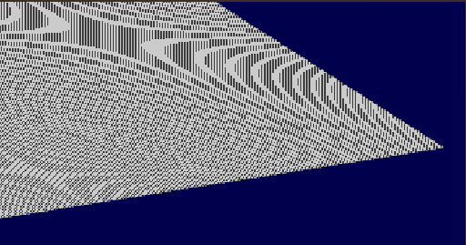
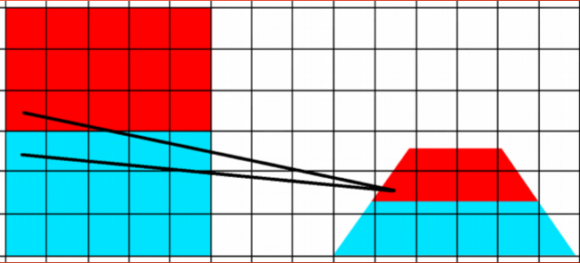
Shadow Mapping – Shadow Acne
● Shadow Acne occurs due to resolution issues.
● Imagine lighting a surface at an angle…
● When rendering from a less slanted angle,
two pixels may converge to one texel on the
shadow map!
● One point could be mistaken as being
behind a point next to it.

Slide 14
Shadow Mapping – Shadow Acne
● Solution: Add a slight bias.
● Effectively moving everything slightly towards the camera to fake a closer depth.
● Try to keep the bias small, or…
● “Peter Panning” occurs.
● Bias offset causes areas close to shadow source to disappear because depth values are close.

Slide 15
Shadow Mapping – Oversampling
● What about areas outside of the Projection frustum used to create the shadow map?
● Values will be outside 0,1 range and therefore always create shadows!
● Solution:
● Set texture type to use border with values all consisting of 0 (always lowest depth value so always lit).
● For values beyond far plane and therefore greater than
1: Initialise to 0.
● See coding video for implementation.

Slide 16
Shadow Mapping – PCF
● Edges of shadows are limited to resolution of texture shadow map is written to.
● This causes unsightly pixelated edges.
● Solution: Sample surrounding Texel and calculate average. Apply only partial shadows for shadowed areas.
● Also known as: Percentage-Closer Filtering (PCF).
● Can get dangerously intensive if not used correctly.

Slide 17
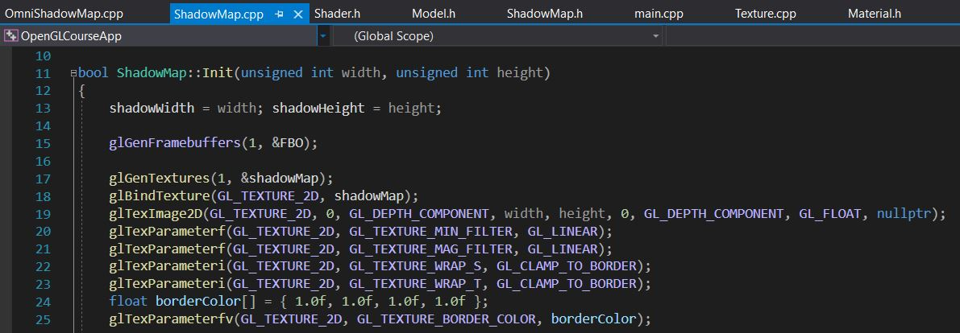
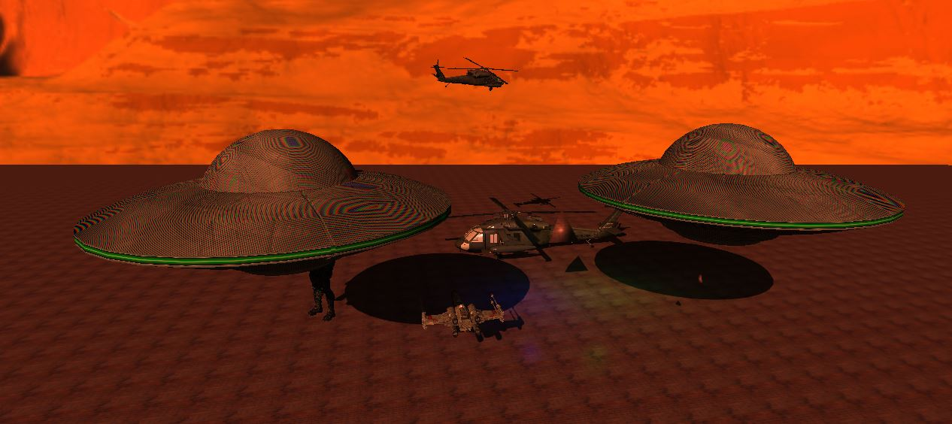
Implementation
● Shadow Mapping Class Code
● Output

Slide 18
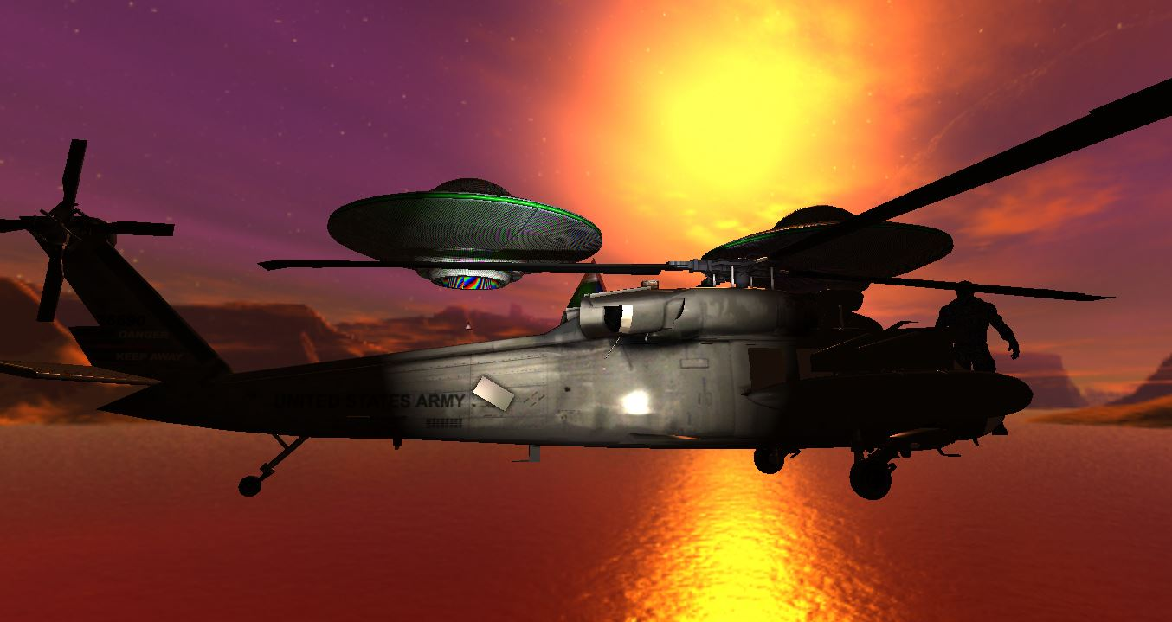
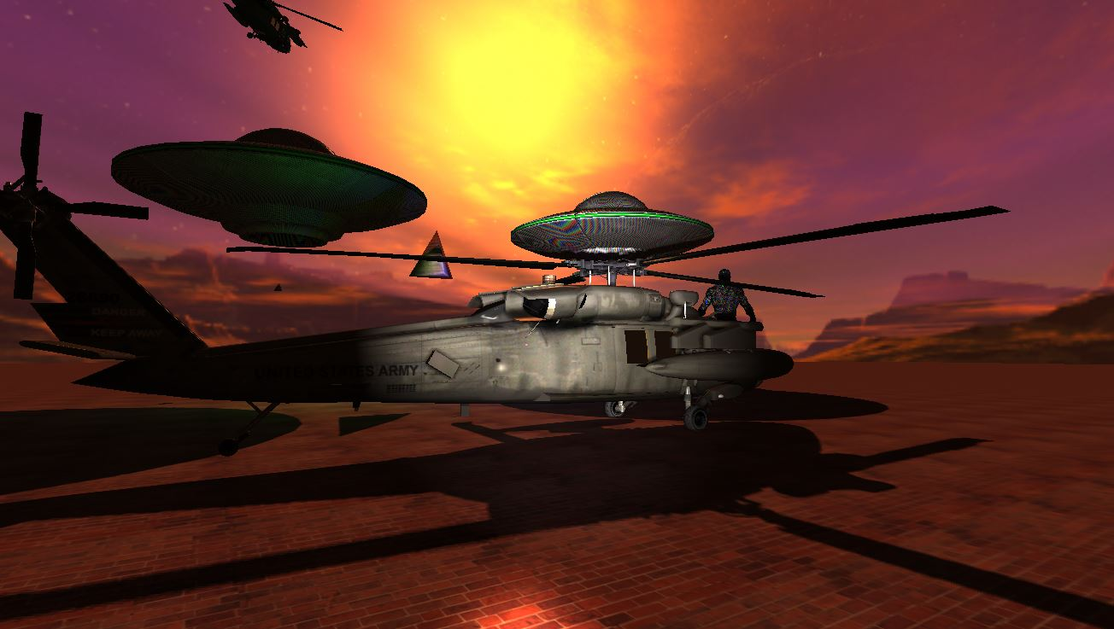
Evaluation
● Without Shadow Mapping ● With Shadow Mapping

Slide 19
Thank you

